Slide 1
Number Systems
Lab 5
Prepared by : Parshant

Slide 2
What is Number System?
It is a way of writing to define numbers.
It uniquely represents each value in a different “arithmetic and algebraic structure of the figures.”
The value of any digit in a number can be determined by three things: The digit, Its position in the number, The base of the number system
Number is a mathematical value used to measure, and make sense of a quantity.

Slide 3
Examples of Variations of Numbers
Prime : Numbers only divisible by themselves and 1.
Odd : Numbers that are not divisible by 2.
Even : Numbers that are Divisible by 2
Positive : Numbers greater than equal to 0
Negative : Numbers less than 0

Slide 4
Types of Number Systems
Decimal number system (Base- 10)
Binary number system (Base- 2)
Octal number system (Base-8)
Hexadecimal number system (Base- 16)
Base defines how many unique symbols a numbers systems has.

Slide 5
Unique Symbols of a Number Systems
Binary : 0 and 1
Decimal : 0,1,2,3,4,5,6,7,8,9
Octal : 0,1,2,3,4,5,6,7
Hexadecimal : 0,1,2,3,4,5,6,7,8,9,A,B,C,D,E,F

Slide 6
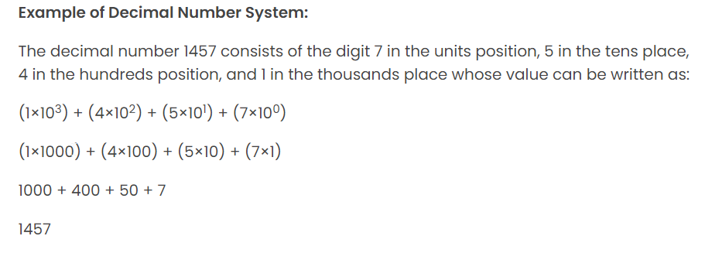
Value of Decimal

Slide 7
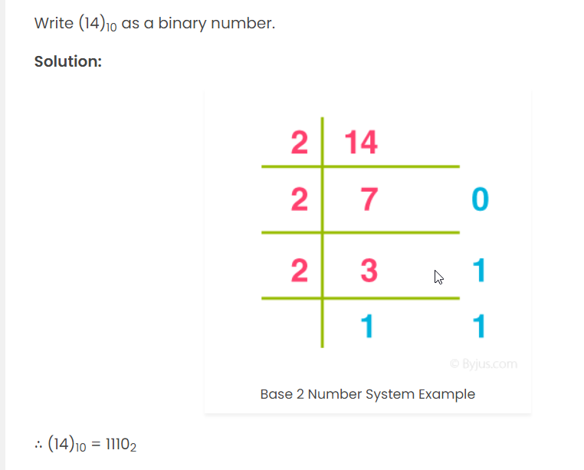
Value of Binary

Slide 8
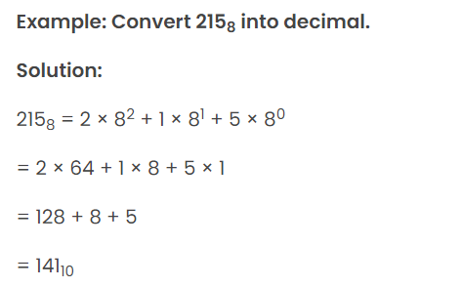
Value of Octal (Octal to Decimal)

Slide 9
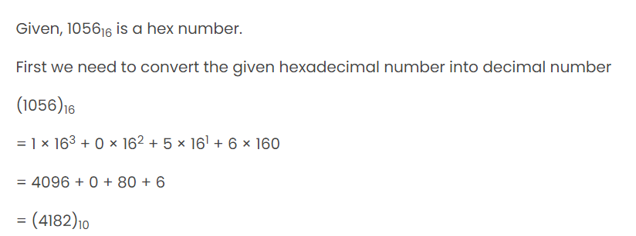
Hexadecimal to Decimal

Slide 10
Agenda of Lab
Understanding the Number Systems
Learning about Negative and 2’s Complement
Number System Conversion
Binary to Decimal
Binary to Hexadecimal
Decimal to Binary
Decimal to Hexadecimal
Hexadecimal to Binary
Hexadecimal to decimal

Slide 11
Operation With Number Systems
Binary addition/Subtraction (including 2’s Complement)

Slide 12
Refences
Google
https://byjus.com/maths/number-system/
Chatgpt

